Slide 1

SUMMARY OF
FACILITIES CONDITION ASSESSMENT
OF
TOWN BUILDINGS
Deerfield, MA
13 February, 2021

Slide 2
OBJECTIVE: provide key information for each building outlining the condition of:
  Site Elements
  Architectural Elements
  Code Issues
  Building Envelope Elements
  Site Elements
  Structural Components
  Mechanical, Plumbing, Electrical and Fire Protection Systems
FINAL REPORT includes:
  summaries for each building of the disciplines noted above;
  prioritization of the recommended repairs or replacement of any element or system, and
  estimated costs for each on a 1-year, 5-year, 10-year and 20-year basis to assist the Town in its planning for capital improvements.

Slide 3
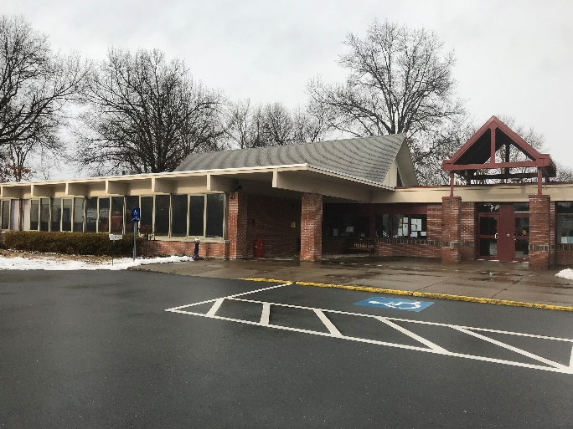
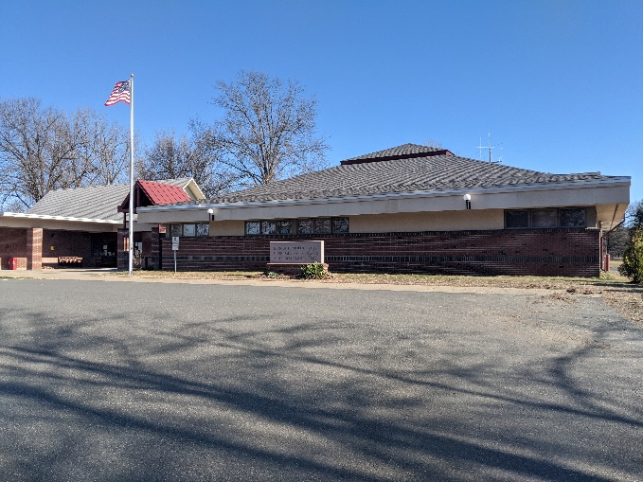
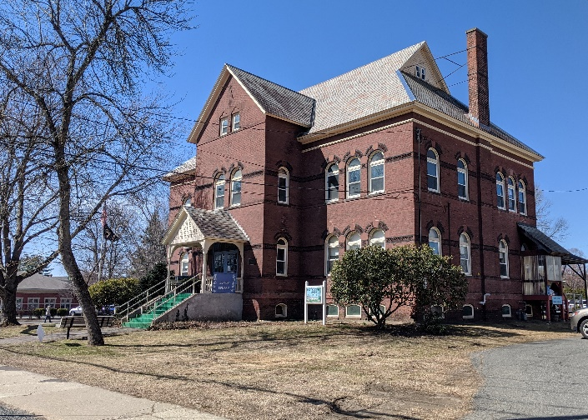
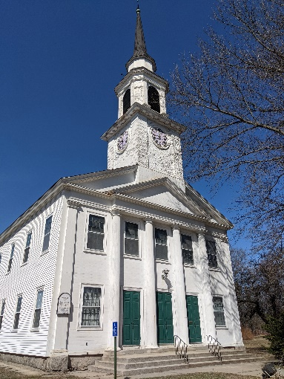
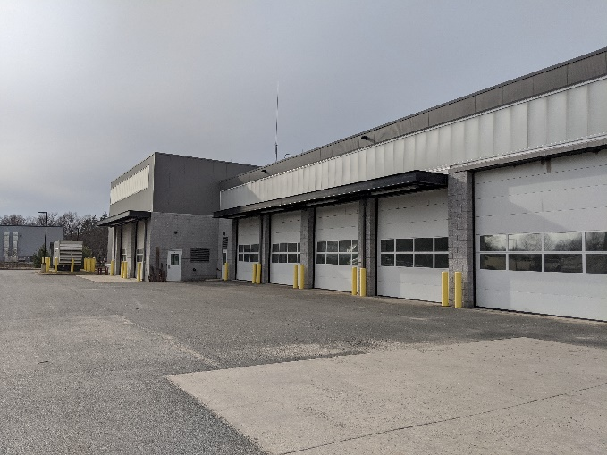
#1 Town Hall
8 Conway Street
#2 Police Station
8 Conway Street
#3 Senior Center
67 North Main Street
#5 DPW
9 Merrigan Way
#4 Congregational Church
71 North Main Street

Slide 4
Immediate Projects
Town Hall | Window replacement Replace (abate) flooring at areas with VAT Replace rotted exterior deck/ steps and ramp at Modular (Assessors) Wing Implement master plan for overall site upgrades
Police Station | Clean/ repair gutter at north wall (Mechanical Room), clean/ repoint masonry; Upgrade exterior lighting and signage/ wayfinding; Replace (3) deteriorated combo sink/ toilets in holding cells; Provide separate entrance for staff without entering booking area
Senior Center | Install a fire alarm system (currently none present); Upgrade interior and exterior emergency lighting; Clear Egress Hallway 102 of stored items obstructing egress. Repair cracked timber beam in Basement level Billiards Room. Repair rusting components of main entry ramp on west (rear) side. Repair main slate roof and roof at rear basement access stairs to mitigate current water leaks.

Slide 5
Immediate Projects
DPW HQ/ Highway Garage | Implement repairs to roof system under existing warranty; Implement program of exterior sealant replacement; Repair damaged interior gypsum wall finish; Repair and cap concrete filled steel bollards.
Congregational Church | Shore up existing belfry tower (currently leaning back) and initiate a further structural study; Further recommendations are contingent on a decision regarding the future use of the building.

Slide 6
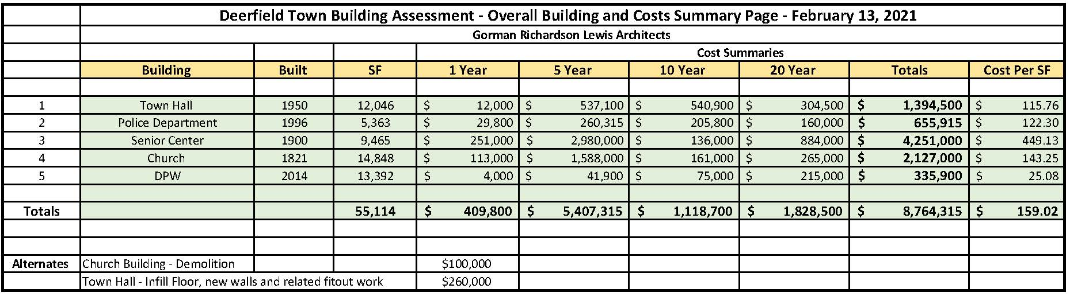
Overall Cost Summary

Slide 7
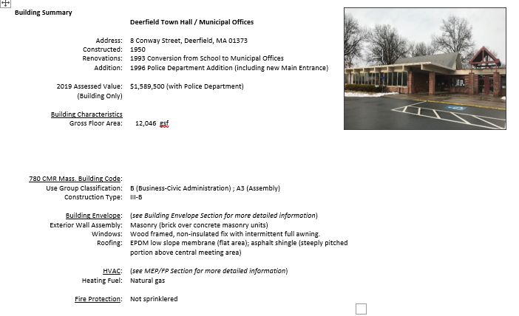

Slide 8
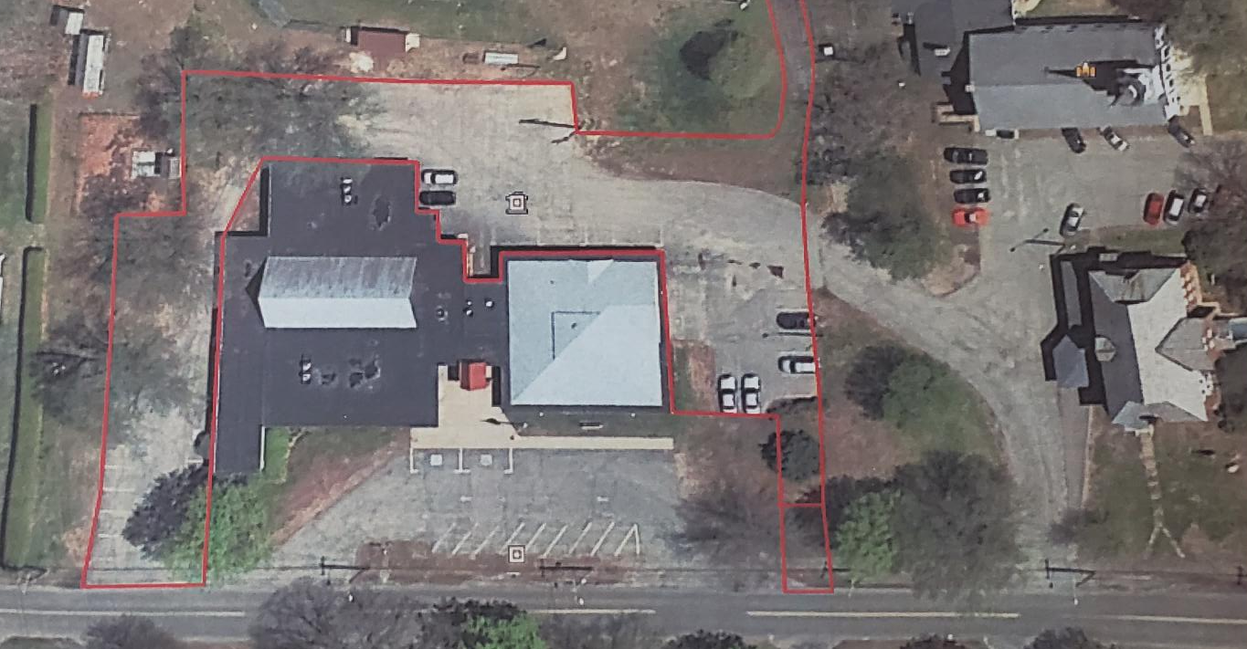


Slide 9
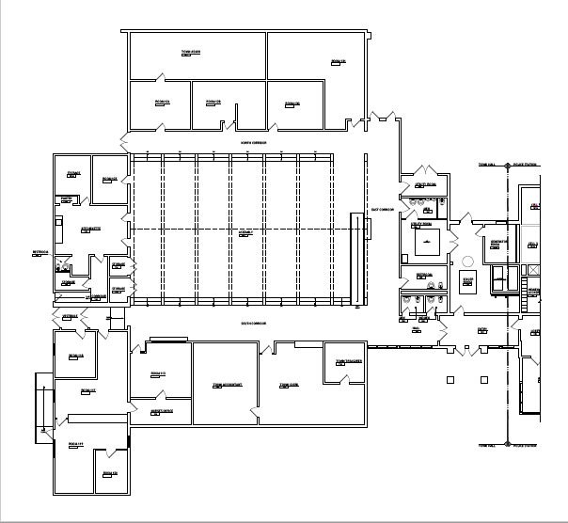

Slide 10
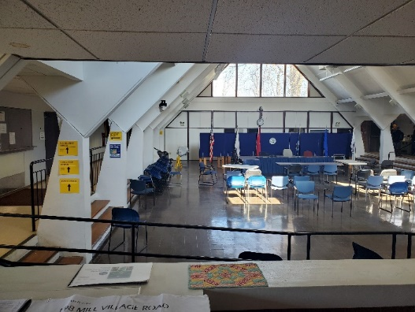
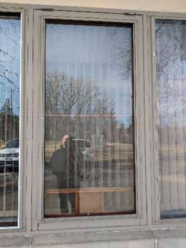
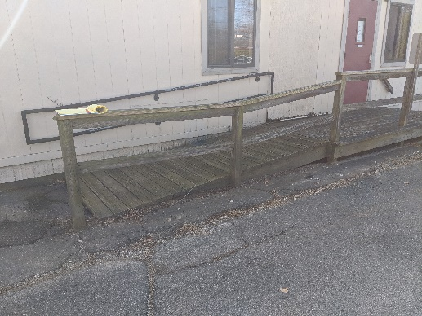
Town Hall
Architecture (interior)
Physical Issues:
Interior Finishes, Furnishings, Signage are aging
Building Envelope issues
Windows have no thermal performance
Modular wing envelope in poor condition
Modular exterior deck/ ramp in poor condition
Functional Issues:
Accessibility deficiencies:
multi-fixtured Men’s Toilet Room;
sunken central Assembly Area;
transaction counters at the Town Clerk
  window and Assessor’s Office;
latch side clearances
Assembly Area deficiencies:
Limits in flexibility to subdivide the space;
Lack of acoustical privacy
Central Assembly Area
Exterior deck/ ramp
Original windows

Slide 11
Town Hall
Options/ Recommendations:
Option
Description
Benefits
Limitations
Recommendation
1
Renovations to the existing building
•
•
Not Recommended
Improve
the service life of the
Does
not resolve
current and
:
limited to interior finishes
building
,
building systems
and
future
space needs;
•
Does
not address existing
upgrades, building envelope
building envelope (exterior)
•
;
Central meeting area remains
function
upgrades and MEP/FP upgrades;
•
Improve
the safety and comfort
sunken and undividable;
al
deficiencies;
of all
occupants , both staff and
•
Restrooms remain spread out and
public;
non
-
accessible.
;
•
Does
not provide for future needs
of Town Hall
as the Town
population increases;
•
Continued use of a building not
designed for a Town Hall;
•
Significant
cost; limited benefit
.
2
Renovations to the existing building
•
•
Recommended
with Limitations
Improve
the service life of the
Higher cost than Option #1;
:
as noted in Option 1 above
and
building and building systems;
•
Continued use of a building not
•
Does
not resolve limitations of
including raised central meeting
•
Improve
the safety and comfort
designed for a Town Hall;
existing
building as a Town
area with enclosing walls and
of all occupants , both staff and
•
May not meet the future needs of
Hall
moveable partitions for
public;
the Town
;
subdividing central meeting space;
H
all as the Town grows
•
Limits
future expansion as
reconfigured restroom/
•
Improves
current space needs
by
and municipal services increase.
Town population grows;
mechanical room areas to provide
efficient reconfiguratio
n of
•
Implementation will be d
isruptive
•
Disruptive
to the day
-
to
-
existing spaces
day
;
to the day
-
to
-
d
centralized, accessible restrooms
ay business of the
business of the Town Hall
Town Hal
and additional office or storage
l.
which is already at its
space.
functional limit
.
Will trigger need for full
accessibility and sprinkler system.
3
Relocate the Municipal Town Hall
•
Fully provides for current and
•
Higher cost than #1 or #2.
Recommended:
offices to a
new location
at a new
future space needs;
•
Provides for the current and
Municipal Facility
•
Resolves all
physical needs;
future needs of the Town as
•
Resolves existing site restrictions;
the population increases and
•
Allows for maintaining existing
more
Town Hall services and
building for re
staff are required;
-
purposing by
Town
or Police Department
;

Slide 12
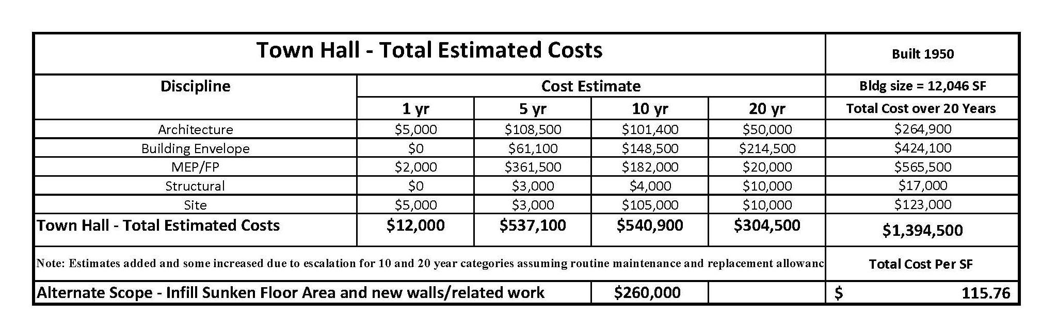
Town Hall

Slide 13
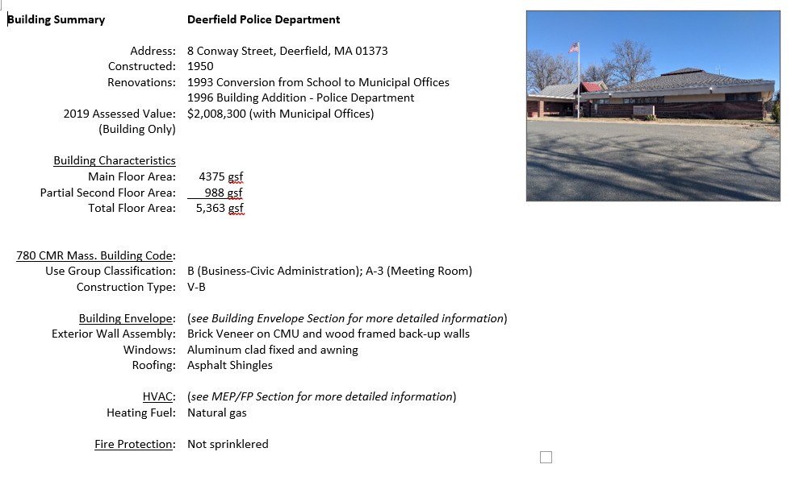

Slide 14
Police Station
Physical Issues (interior)
Overall building is in functional and sound condition.
Interior:
Existing combo plumbing fixtures in the 3 holding cells are deteriorating.
Interior finishes are aging
Exterior (Envelope)
Deteriorated brick masonry at recessed access alcove to the Mechanical Room at the rear (north side) of the building.
Roof in good condition
Functional Issues:
Insufficient space :
  office space;
  conference room space;
  waiting area for public and visitors;
  accessible public restroom;
  dedicated employee entrance outside of holding/booking area;
  forensic facilities;
  specialized storage space (guns/ ammunition; evidence storage in a controlled environment);
  general storage;
  fitness room for police staff;
  garage space.

Slide 15
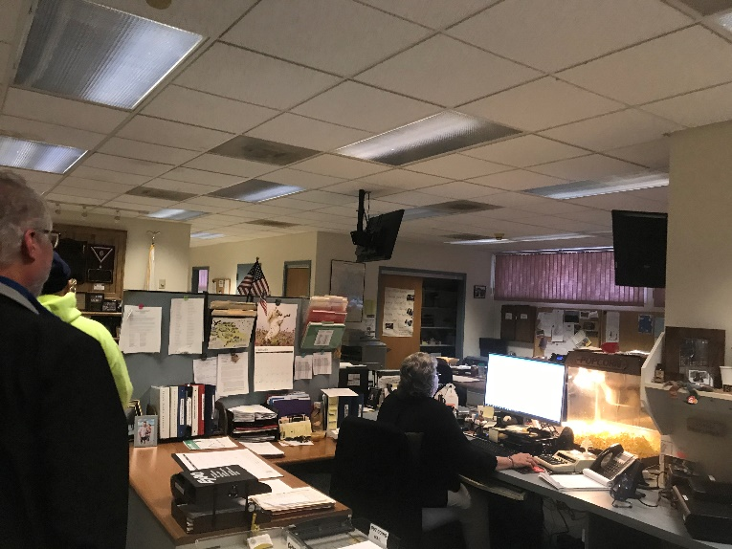
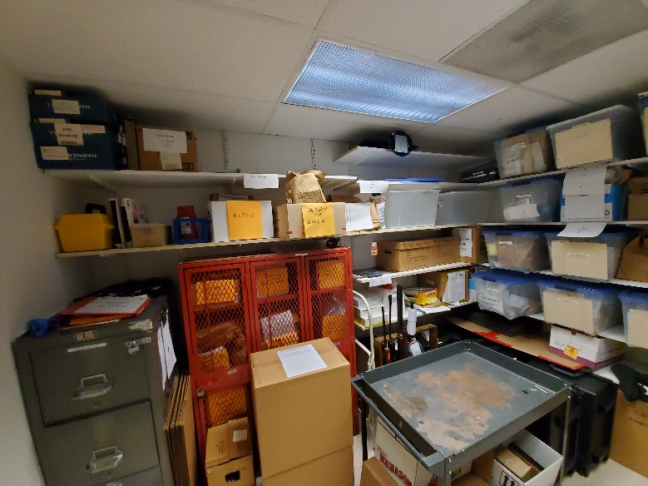
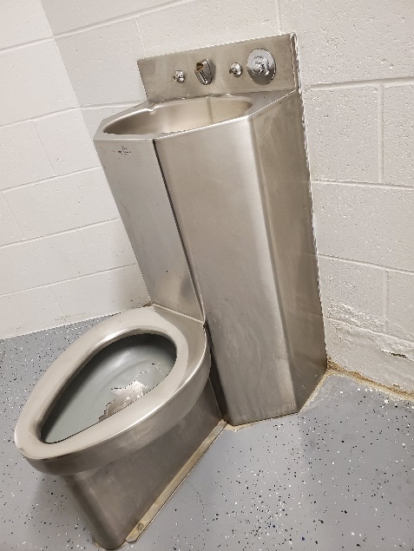
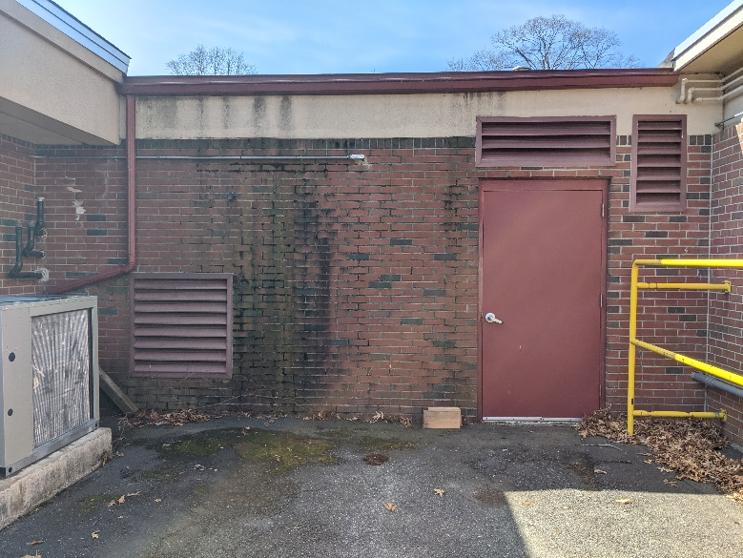
Police Station
Interior Finishes
Limited Storage
Holding cell fixtures
Masonry at North Wall

Slide 16

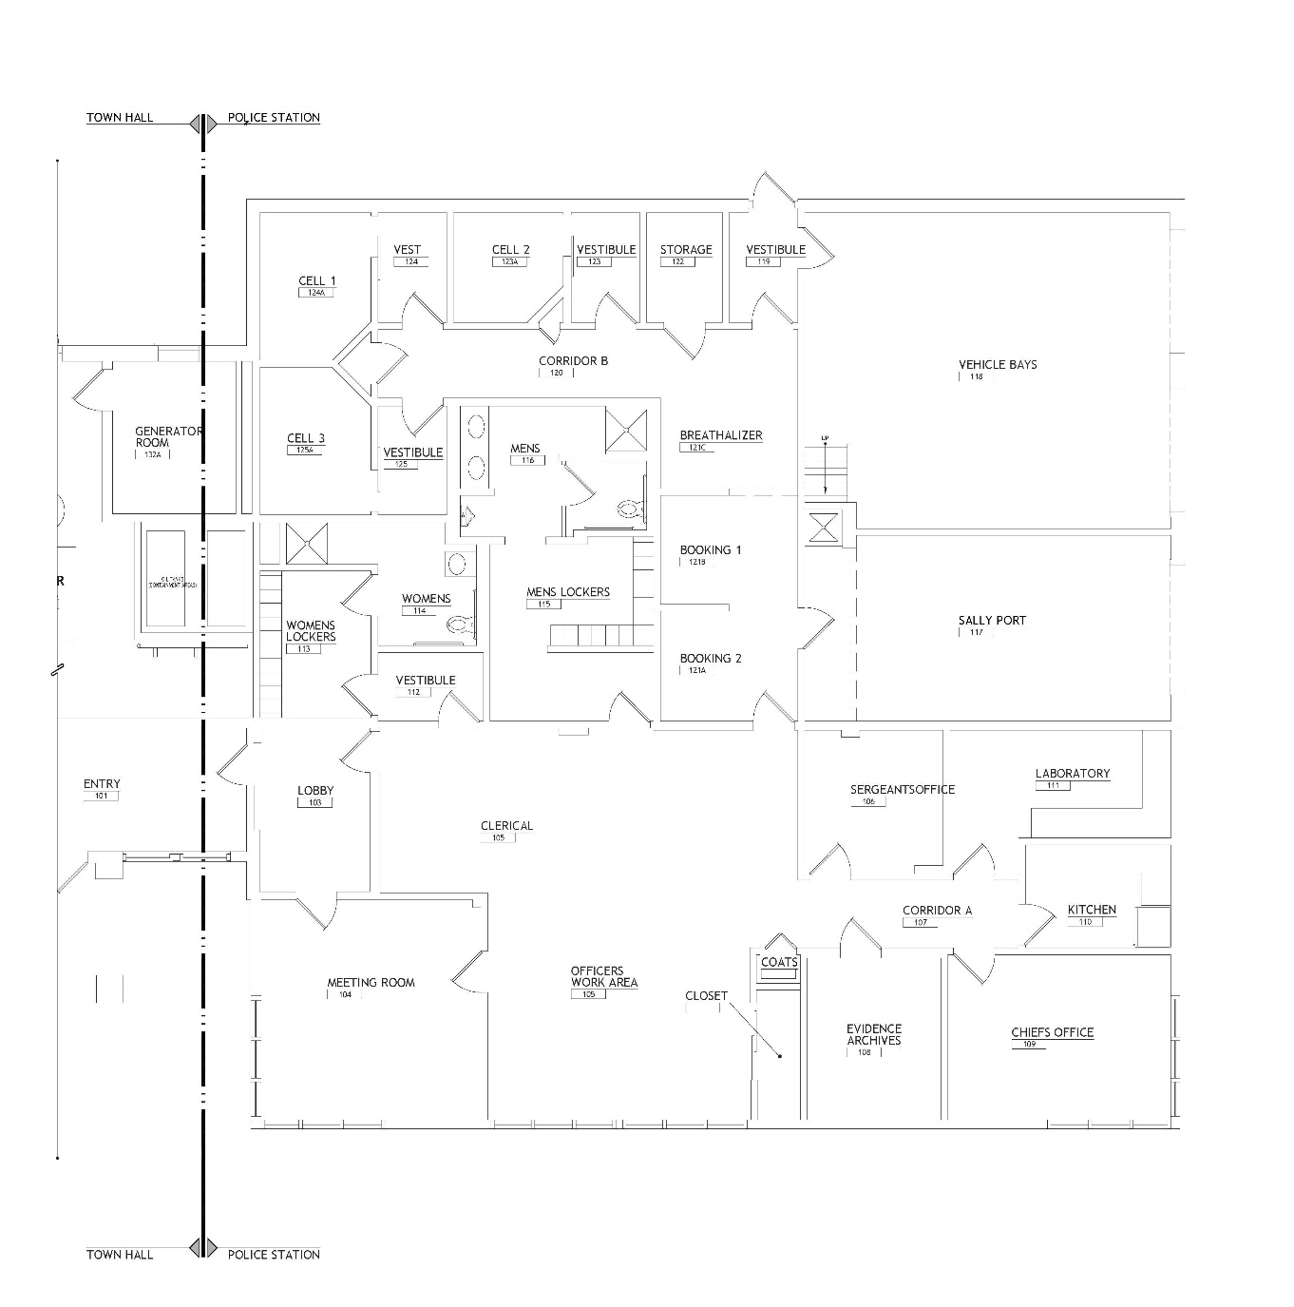

Slide 18
Police Station
Mechanical/ Electrical/ Plumbing/ Fire Protection:
Physical Issues:
Mechanical:
  Shares system with Town Hall
Electrical:
  Electric service and automatic transfer switch are new and area in good condition.
  This service is undersized and there is no room for expansion on this system.
  Subpanels are in fair condition and should be replaced.
  Additional receptacles shall be installed in areas where extension cords are being used.
  All existing fluorescent lighting should be replaced with new energy saving LED type fixtures.
  Occupancy sensors should be installed to conserve energy when space is unoccupied.
  Provide emergency battery units throughout the facility to meet life safety requirements.
  The present fire alarm system is obsolete and should be replaced with a new addressable system.
Plumbing:
  Plumbing fixtures are in good condition; upgrade with new high efficiency fixtures.
  domestic hot water heater is close to the end of useful life;
  Provide accessible fixtures for holding cell
Fire Protection:
  The building does not contain an automatic sprinkler system.
  MA General Law M.G.L. c.148, s.26G requires that any existing building over 7,500 square feet that undergoes major alterations or building addition must be sprinklered.

Slide 19
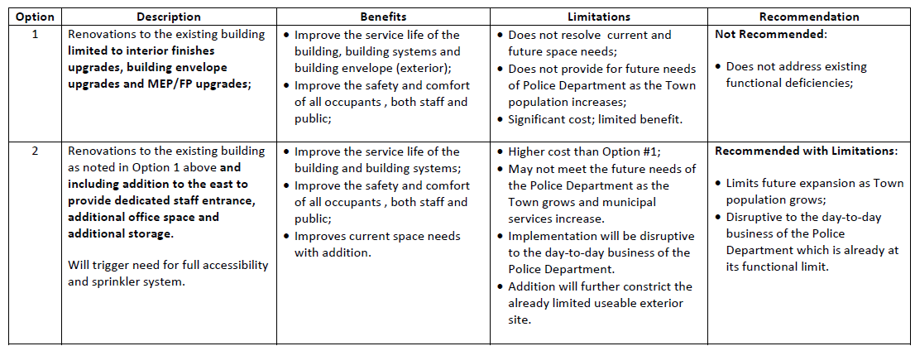
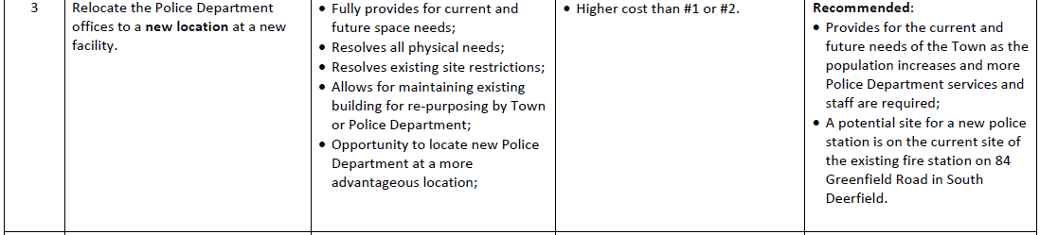
Police Station
Options/ Recommendations:

Slide 20
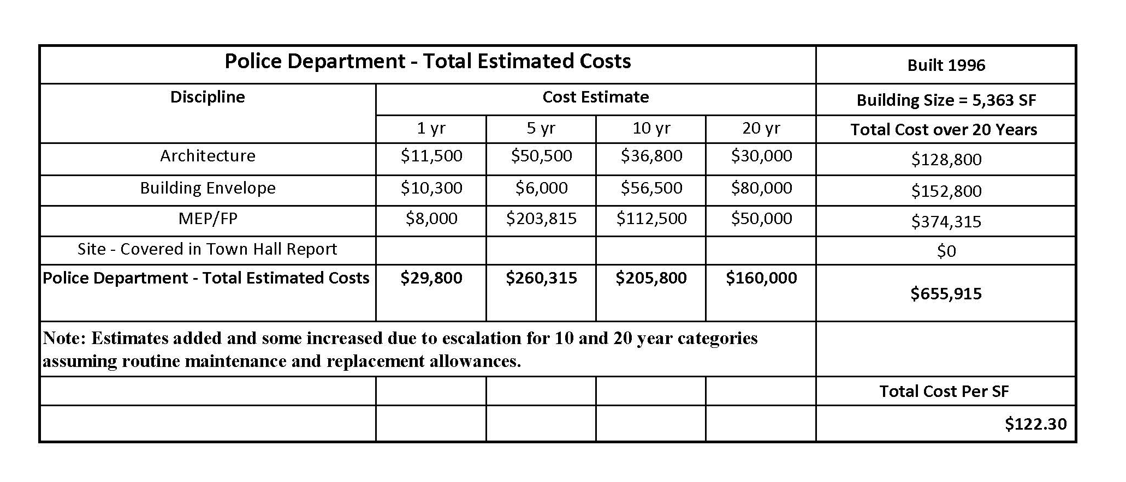
Police Station

Slide 21
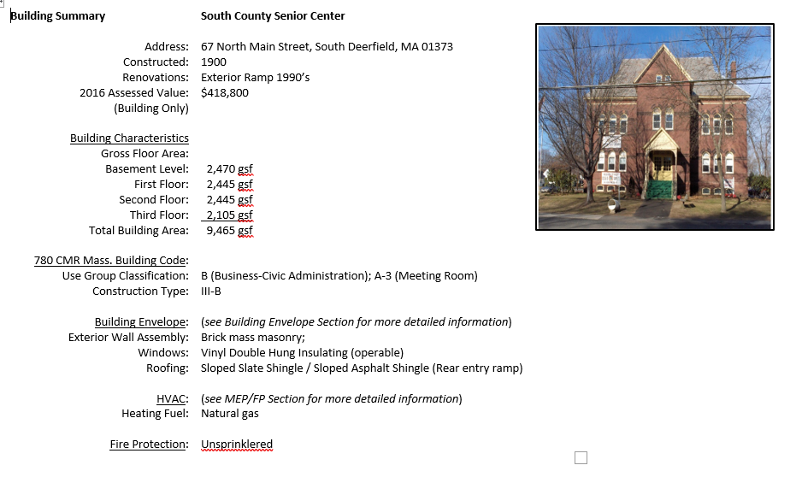

Slide 22
Senior Center
Architecture (interior)
Physical Issues:
Basement Level:
Currently unoccupied
Overall condition is poor and not suitable for occupancy.
Concern regarding lead paint and mold;
Moisture level is elevated resulting in poor air quality and exacerbating the conditions for mold growth.
First Floor Level:
Due to the deteriorated condition of the other 3 levels as well as the absence of an accessible means to access those levels, the functions and services provided within the Senior Center are restricted to the First Floor.
Finishes, furnishings and equipment throughout the First Floor level are older and very near or at the end of their service life.
Second Floor Level:
Currently unoccupied and appears to be used for general, miscellaneous storage;
Configuration and finishes appear to be relatively unchanged from the time the building was a school, with the exception of a more modern fire alarm system and replacement windows.
Overall the floor level is in poor condition and will require extensive renovation to be occupiable.
Third Floor Level:
Unoccupied with the southern one-third of the level unfinished;
Central portion finished with what appears to have been a performing or lecture area with stage;
Northern one-third of the level partially finished with 3 rooms inboard of the exterior walls.
These spaces were once finished with painted plaster walls and ceilings, wood cased door openings and wood strip flooring. However, they are now in extremely deteriorated condition.
Functional Issues:
Insufficient office space for the growing needs of the fire department;
Lack of dedicated conference room space for Police Department staff training and meetings;

Slide 23
Senior Center
Architecture (interior) Continued
Functional Issues:
Basement Level, Second Floor and Third Floor are not in occupiable condition and are not handicap accessible;
Only one entrance provides handicap accessibility to the First Floor;
The First Floor alone is occupiable but is of limited size for the present and future needs of a regional senior center;
Parking for the Senior Center is very limited and not well defined.

Slide 24
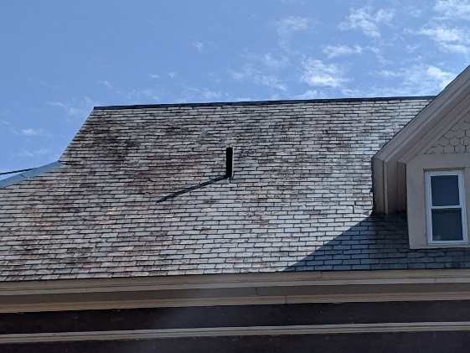
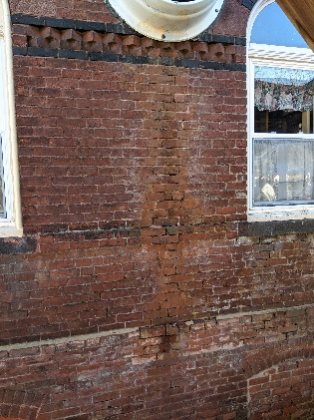
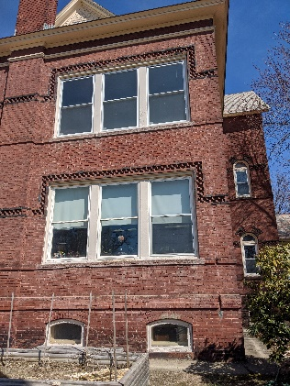
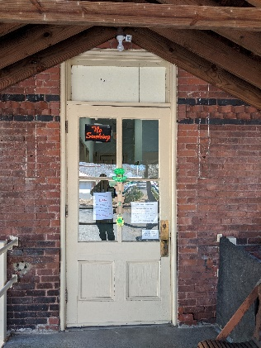
Senior Center
Building Envelope (exterior)
Physical Issues:
Roof:
  Existing slate roof is beyond its service life and requires replacement with a new roofing system, including new gutters and downspouts;
Cladding:
  Exterior brick masonry walls are in severely deteriorated condition and require 100% repointing including replacement of broken bricks and cast stone sills;
  Concrete apron between the base of the brick wall and adjacent finish grade is cracked with gaps between the concrete and face of the brick wall.
Windows/ Doors:
  Windows are vinyl double hung units near or at the end of their service life.
  Doors are older wood doors and hardware in deteriorated condition and at the end of their service life.
Slate Roof
Brick Cladding
Vinyl Windows
Wood Doors

Slide 25
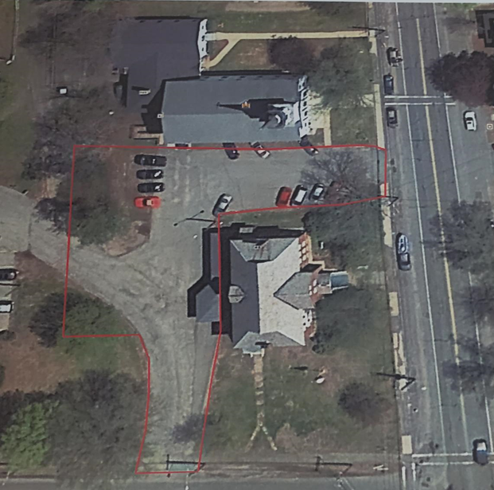
Senior Center
Site
Physical Issues:
Driveways/ Parking Areas:
  Cracked and deteriorated pavement at driveways and parking areas;
  Poorly defined parking spaces;
Walkways, Ramps, Steps:
  East concrete walkway (N. Main Street side) is in fair;
  Other walkways at the south, west and north are in poor condition.
  Existing west (rear) entry ramp is serviceable but not fully accessible
Landscaping:
  Lawn areas are in poor condition and require rejuvenation and tending, including trim and border detailing at all walkway and driveway edges.
  An overall assessment and landscape design should be implemented for the health of the plantings and the beatification of the property.
Signage:
  Insufficient exterior lighting;
  Insufficient exterior signage for parking and wayfinding;
  Need for an overall site evaluation and upgrade design.

Slide 26
Senior Center
Mechanical/ Electrical/ Plumbing/ Fire Protection:
Physical Issues:
Mechanical:
  Boiler: The existing boiler is high efficiency, wall mounted condensing boilers in good condition;
  Boiler plant is likely not operating at its full turndown potential due to older heat sources not aligned with new boiler.
  Replace existing Kitchen exhaust fan
  Replace bathroom exhaust fans.
  Add air conditioning to building;
  Add a building management system for remote monitoring of space temperature and equipment operation.
Electrical:
  Electric service is undersized for any future upgrades.
  Quantity of receptacles not adequate for current needs.
  Two prong type receptacles in some areas of the building.
  Interior lighting and switching are antiquated and/ or not functioning
  Emergency lighting appears inadequate;
  There is no fire alarm system installed in this building.
  There are a few battery operated smoke detectors installed in the basement and first floor only, none on the second and third floors.
Plumbing:
  Plumbing fixtures are in fair condition, but in general the fixtures do not meet current standards.
  Domestic hot water is not recirculated, and system does not have an expansion tank.
  Kitchen waste line does not have a grease interceptor.
  There is no drinking fountain.
Fire Protection:
  The building does not contain an automatic sprinkler system.
  MA General Law M.G.L. c.148, s.26G

Slide 27
Senior Center
Options/ Recommendations:
Option
Description
Benefits
Limitations
Recommendation
1
Renovations to the existing
•
•
first
Not Recommended
Improve
the service life of the
Does
not resolve
current and
:
floor (current Senior Center)
building
,
building systems
and
future
space needs;
•
limited to interior finishes
building envelope (exterior)
•
Does
not address existing
;
Does
not provide for future needs
function
al
deficiencies
upgrades, building envelope
•
Improve
the safety and comfort
of
Senior Center
as the Town
.
upgrades and MEP/FP upgrades;
of all occupants , both staff and
population increases;
public;
•
Significant
cost; limited benefit
.
2
Full building renovation including
•
Improve
the service life of the
•
Higher cost than Option #1;
Recommended:
new elevator for access to all
levels,
building and building systems;
•
Requires temporary
relocation of
fit
•
Resolves the physical and
-
out of basement and second
•
Improve
the safety and comfort
senior center during renovation.
floor spaces to accommodate space
of all occupants , both staff and
functional deficiencies faced by
needs of a regional senior center,
public;
the existing senior center;
exterior building envelope
•
Improves
current space needs
•
Maintains a prominent and
renovations/ upgrades; building
with addition.
useful building central to the
system (MEP/FP) upgrades.
municipal campus;
•
Can accommodate needs of
Will trigger need for full
building
other co
mmunity groups in
accessibility and
sprinkler system.
addition to seniors
3
Relocate the
Senior Center
offices
•
•
Recommended
Fully provides for current and
Higher cost than #1
and possibly
if
alternate site is
to a
new location
at a new
facility.
made available
future space needs;
of #2.
:
•
Resolves all physical needs;
•
Requires an available town
•
Provides for the current and
-
future needs of the Town
•
Resolves existing site restrictions;
owned site.
.
•
Allows for maintaining existing
•
A potential site for a new
building for re
senior center
is on the current
-
purposing by
Town
or
Senior Center
site of the existing
adjacent
;
•
Opportunity to locate new
Senior
Congregational Church.
•
Maintain current o
perat
ions
Center
at a more advantageous
.
location;

Slide 28
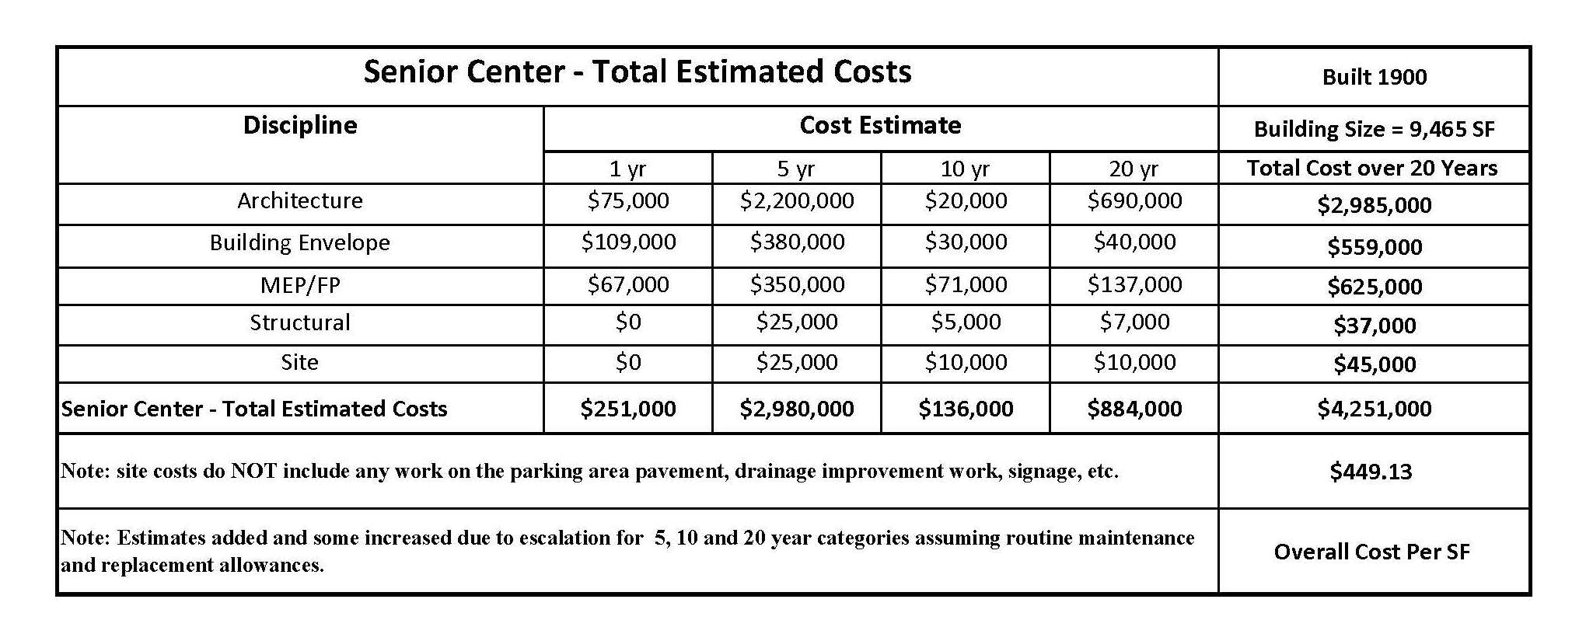
Senior Center

Slide 29
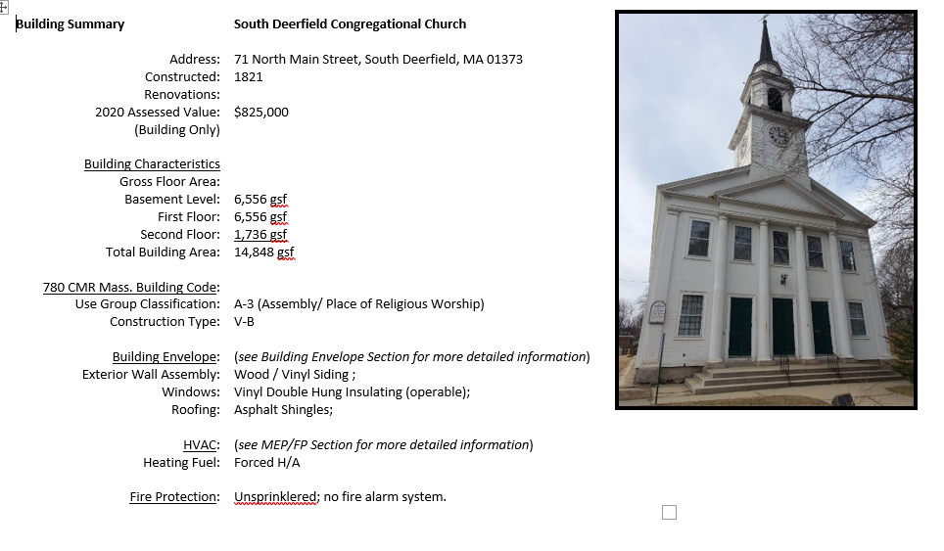

Slide 30
Church
Architecture (interior)
Physical Issues:
deterioration of interior floor, wall and ceiling finishes;
aged condition of kitchen equipment;
severely deficient condition of basement areas;
severe deterioration of exterior building envelope components…roof, walls, foundation, windows, doors, site
significant structural deficiencies:
  steeple
  exterior columns ;
  First floor framing
  Second floor framing
mechanical (HVAC) , electrical, plumbing and fire protection deficiencies
Functional Issues:
Code Issues:
  Handicap accessibility
  Building code change in level between the Sanctuary area and the Kitchen/ Office area;
constricted layout of the Kitchen/ Office area;
lack of exterior walkways;
limitations in re-purposing existing interior spaces for something other than assembly space.

Slide 31
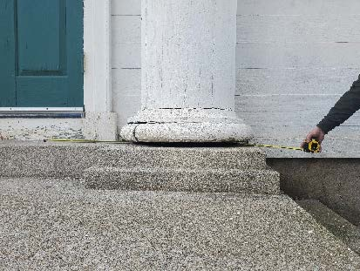
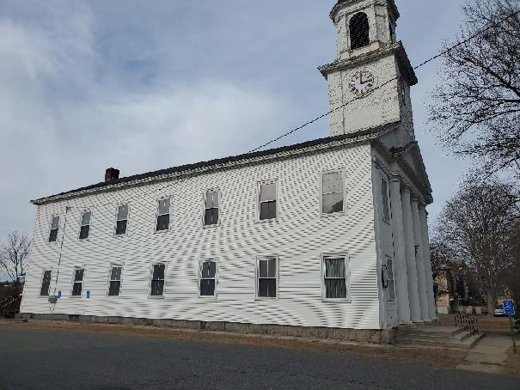
Church
Structural
Foundation:
  Several brick piers supporting the main hall floor are deteriorated with disintegrating mortar and spalling brick.
  Front exterior stairs supporting pediment columns appears to be settling leaving a gap of about 1” below the northern column.(see Fig. 1)
Upper Floor:
  There is a noticeable settlement of 2”- 4” towards the center aisle of the main hall.
Steeple:
  Northwest support post (1 of 2) is severely rotted at its base and no longer in contact with the diagonal timber transfer beam. In each corner there are two timber posts resting atop a diagonal timber transfer beam. The top of this beam is also exhibiting signs of rot from either insects or moisture. This is likely the cause for the steeple out-of-plumbness.(See Fig. 2)
  Timber planks, stairs and catwalks within the belfry are severely rotted.
Fig. 1
Fig. 2

Slide 32
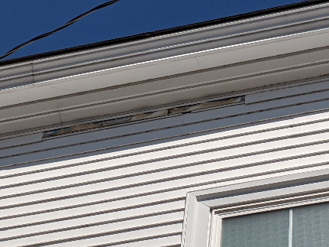
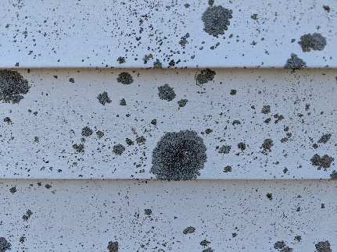
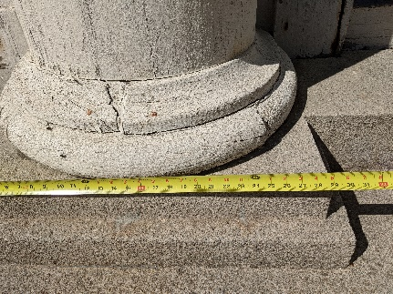
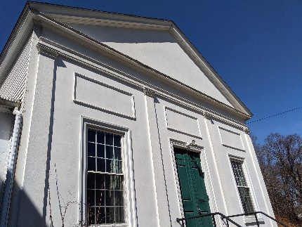
Church
Building Envelope (exterior)
Physical Issues:
Roof:
  traditional 3-tab asphalt shingles in fair condition;
  Organic growth on rear portion;
  Interior staining indicates some leaks;
  Monitoring on flashings and penetrations required.
Cladding:
  Primarily vinyl clapboard with areas of painted flush wood boards and stucco .
  Vinyl in fair condition but with areas of cracked and/or missing sections;
  Staining and organic growth at some areas;
  Wood columns/ pilasters are painted wood stave construction in fair condition. Bases are deteriorated.
Windows/ Doors:
  Windows are primarily original wood double hung, single-glazed with wood muntins with aluminum storm/ screen units;
  Windows are beyond their service life.
  Aluminum storm/ screen units are in fair condition.
  Doors are older wood doors and hardware in deteriorated condition and at the end of their service life.
Missing vinyl siding
Stained vinyl siding
Column bases
Stucco at Auditorium

Slide 33
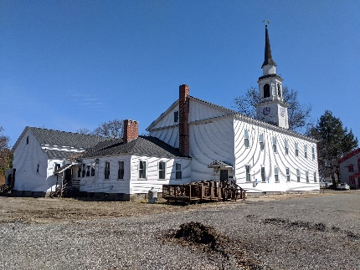
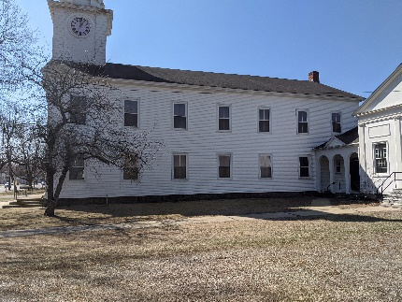
Church
Site
Physical Issues:
Driveways/ Parking Areas:
  pavement is in fair condition. However, there is no stripping designating parking spaces, including accessible parking spaces.
Walkways, Ramps, Steps:
  Concrete walkways are in serviceable condition but sufficiently worn to warrant replacement.
  there are no paved walkways at the rear of the building.
Landscaping:
  Lawn and planted areas are restricted to the front, right side and rear of the building and are in fair condition.
Signage:
There is no exterior site signage for wayfinding and parking designations.
Aerial View
Site at rear
Site at front

Slide 34
Church
Options/ Recommendations:
Option | Description | Benefits | Limitations | Recommendation
1 | Renovations to the existing building to accommodate a change of use | Maintains the original building and its historic value. | Extensive renovation required to mitigate the many physical and code deficiencies. Change of use will trigger accessibility, sprinkler and other code-related upgrades | Not Recommended : The cost for renovation will likely exceed the cost to replace the existing building. Repurposing of the existing building will limit the needs of any use determined for the property.
2 | Demolish existing building providing a clear site to make the open site available for development by the Town. | The prominent site would be made available for a new municipal building. | Loss of the original building and its historic and sentimental value. | Recommended: Most cost-effective approach to dealing with a vacant town-owned building Provides an open site for development of a municipal use as part of the overall municipal campus.

Slide 35
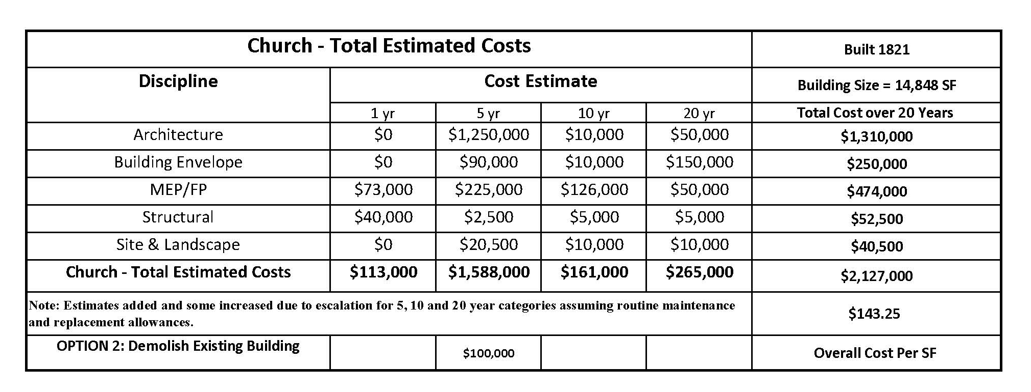
Church

Slide 36
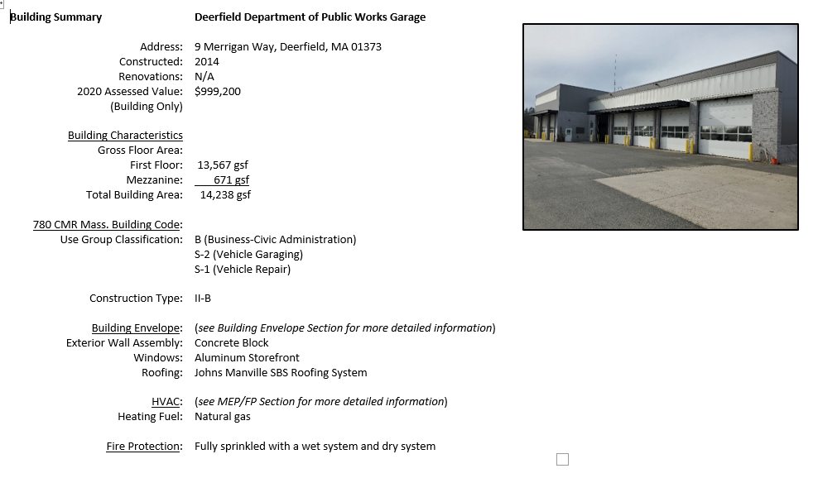

Slide 37
DPW
Architecture (interior)
Physical Issues:
Generally in good physical condition.
No violations of the Massachusetts State Building Code and accessibility code were observed.
Interior Finishes:
Some areas of damaged gypsum wallboard due to water infiltration from building envelope.
Functional Issues:
Additional storage space.
A larger Conference Room / Lunch Room to be able to accommodate all employees at the same time.
More office space to accommodate the necessary desks / office space needed by the DPW.

Slide 38
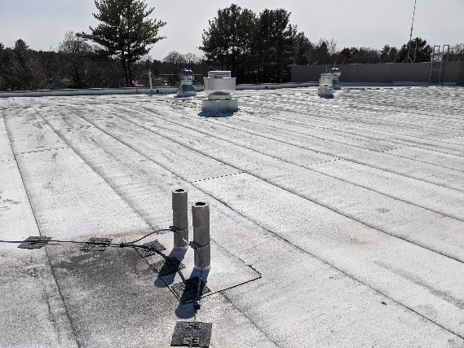
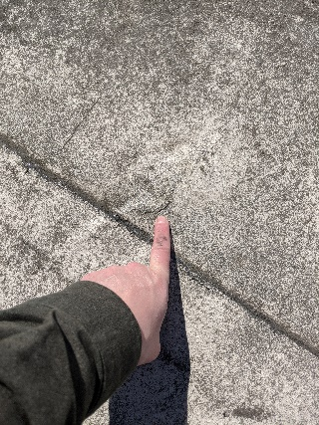
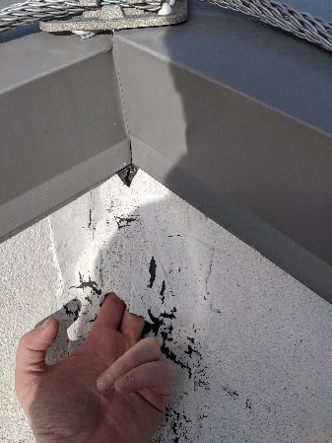
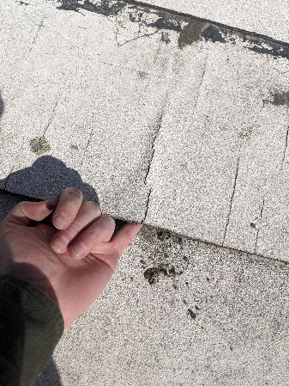
DPW
Building Envelope (exterior)
Physical Issues:
Roof:
  Existing membrane roof system is showing signs of degradation.
Existing membrane
Cracked membrane
Holes in membrane
Deteriorated seam

Slide 39
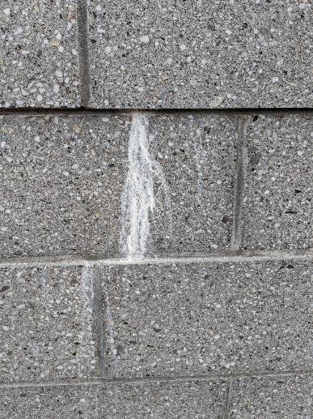
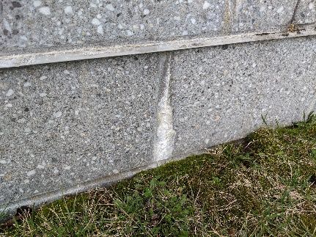
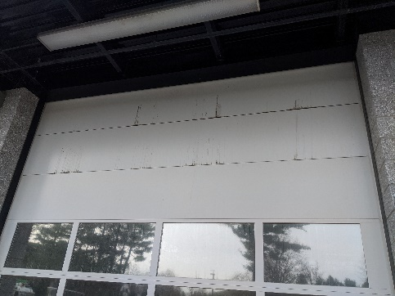
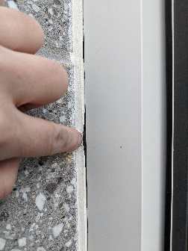
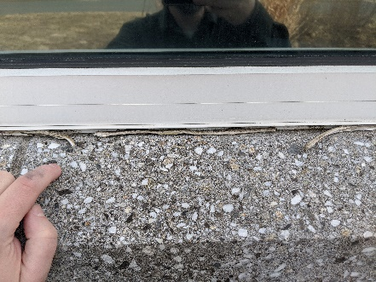
DPW
Building Envelope (exterior)
Physical Issues:
Cladding:
  Cladding is comprised of CMU block walls and insulated metal panels. Both are in satisfactory condition;
  Lime run (heavy efflorescence) observed at CMU block wall at some areas.
Windows/ Doors:
  Aluminum frame windows appear to be in satisfactory condition;
  Doors in general are in serviceable condition with no significant signs of issues.
  Overhead doors show signs of dirt staining at section joints.
Sealant:
  sealant at perimeter of the windows was observed to be delaminated from adjacent surfaces.
Lime Run
Staining at overhead doors
Delaminated sealant

Slide 40

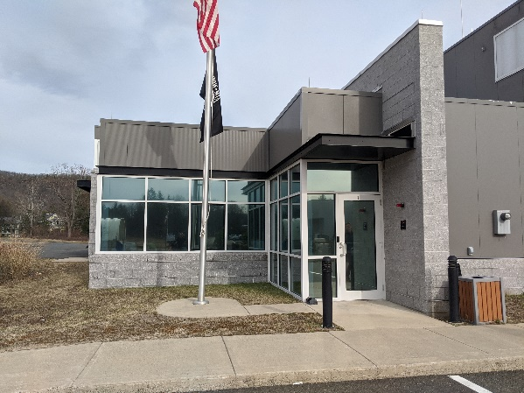

DPW
Site
Physical Issues:
Driveways/ Parking Areas:
  Paving is in good condition;
  site has defined parking and travel lanes with painted markings.
Walkways, Ramps, Steps:
  Concrete walkways are in satisfactory condition;
  Some bollards around the building and site have concrete pushing up out of the steel tube due to moisture getting inside.
Landscaping:
  Lawn and planted areas are in fair to good condition.
Signage:
  Exterior site signage for wayfinding and parking designations is adequate
Paved areas
Concrete Walkways
Bollards

Slide 41
DPW
Mechanical/ Electrical/ Plumbing/ Fire Protection:
Physical Issues:
Mechanical:
  Overall the building and HVAC systems are relatively new and appear to be operating at design conditions.
Electrical:
  Electric service and automatic transfer switch are new and are in good condition.
  All devices are new and in good condition.
  All existing fluorescent lighting should be replaced with new energy saving LED type fixtures.
  All equipment is relatively new and in good condition.
  Fixtures are LED type and are in good condition.
  The coverage of fire alarm devices appears to be adequate. The present system is new and in good condition.
Plumbing:
  Building was constructed in 2014 and all plumbing systems are in good condition.
Fire Protection:
  The building is fully sprinkled with a wet system and dry system. The system was installed in 2014 and is in good condition.

Slide 42
DPW
Options/ Recommendations:
Option
Description
Benefits
Limitations
Recommendation
1
Implement scheduled maintenance
•
•
Recommended
Improve
the service life of the
None
:
program for all equipment and interior
building
,
building systems
and
•
finishes.
And address current physical
building envelope (exterior)
Maintains integrity of building.
;
deficiencies noted in the matrices.
•
Improve
the safety and comfort
of all occupants , both staff and
public;
2
Plan and implement
a future
addition to
•
•
Recommended
for future
Improves
current and future
None
:
the Administrative Area (Offices and
space needs
with addition.
Lunchroom) to accommodate increase of
•
Provides needed space for the
staff over time.
growth of the Department

Slide 43

DPW

Slide 44
End of Summary

